Slide 1
Headphone Experiment

Slide 2
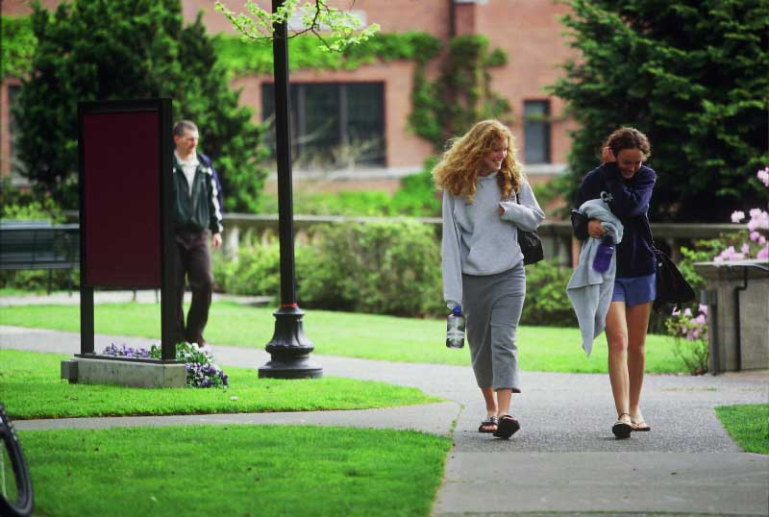

Research Question
What is the proportion of students that wear headphones while walking on campus?

Slide 3
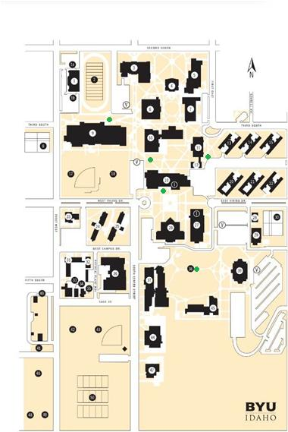
Design the Study
We observed the students walking on campus to see if they were wearing headphones or if they were not.
Population = all BYUI students
Analysis Tool = confidence interval for one proportion
We selected five spots around campus (highlighted by a green dot) for each group member to observe students walking between classes.

Slide 4
Collect the Data
Each member of the group observed the students walking by, at one of the five predetermined spots, for 10 minutes. We did this twice during the week at the same spot, but at different times.
During each observation session we would mark each person that passed by as either "yes" or "no" -- "yes" if they were wearing headphones, and "no" if they were not.

Slide 5
Collect the Data
After everyone completed their observations we compiled the data and organized it in the following table.
Location | Yes | No
Skybridge | 22 | 105
MC | 94 | 409
Gardens | 46 | 145
Hart | 53 | 120
Smith Building | 52 | 170
Total | 266 | 949

Slide 6
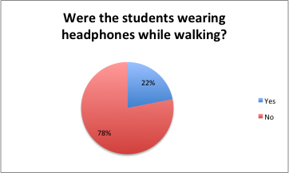
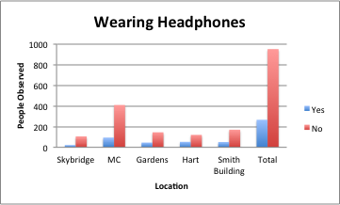
Describe the Data
Total proportion of headphone wearers in our sample was 21.9%.
We are 95% confident that the true population proportion is between 19.7% & 24.3%.

Slide 7
Describe the Data
Proportions of data taken at the different locations vary. This could indicate that depending on the location students are more likely to wear headphones.
Students walking near the MC and Skybridge are less likely to be wearing headphones.
Students walking towards the hart are the most likely to be wearing headphones.
Location | Proportions
Skybridge | 0.173
MC | 0.187
Gardens | 0.241
Hart | 0.306
Smith Building | 0.231
Total | 0.219

Slide 8
Make Inference
The requirement for a one proportion confidence interval is that the sample size is at least 5.
n = 1215>5, so this requirement is satisfied

Slide 9
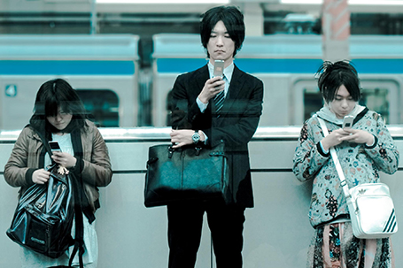
Does Action Need to be Taken?
Many people advocate that the people in the world are closing themselves off from each other, we set out to see if this was true. Do people prefer to wear headphones and listen to music instead of interacting with their fellow peers?

Slide 10
Does Action Need to be Taken?
Our original thought was that about half of the people on campus would be found to be wearing headphones. But as we collected the data we were surprised to see that number was more like 20%.

Slide 11

If you are one of those advocates for not closing yourself off from others, you will be pleased to see that dramatic difference. Therefore at this time no action needs to be taken.

