Slide 1

Introductory Statistics
Introductory Statistics

Slide 2
Suggest slides
These slide suggestions may form a valuable part of your first day of class, but will probably not take the whole hour
Pay attention to the “notes” section of each slide for my detailed instruction/ideas.

Slide 3
Overview
Introductions: who am I, who are you?
How to succeed in the course?
Tour of the syllabus / I-learn
Notes:
Activity to break the ice and help students connect with you and with each other.

Slide 4
Overview
Introductions: who am I, who are you?
How to succeed in the course?
Tour of the syllabus / I-learn

Slide 5
Course Promise
By the end of the course you will be able to:
correctly interpret statistically based results reported in media
recognize situations where statistics would be useful
summarize data with graphs and numbers using spreadsheets
recognize the role of variability and randomness in statistics
Use inference to make generalizations and draw conclusions
Interpret typical statistical software output Apply probability distributions to investigate questions
Notes:
GAISE College Report 2016

Slide 6
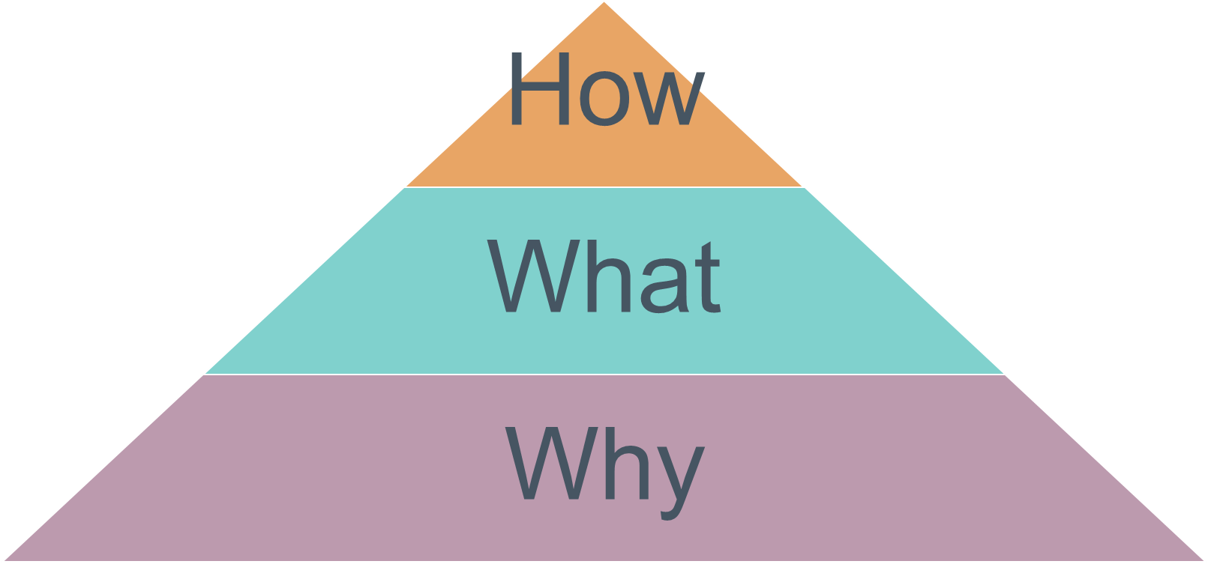
Those who success have found their “why”
Before walking through the syllabus (“how” and “what”), students need to have a clear vision of why they are in this course.
Angela Duckworth: Grit/Reslience
Notes:
Encourage students to think beyond just “because it’s required”.

Slide 7
Those who success have found their “why”
What this video, then take 1 minute to write a “why” statement: you reason for being here.
Angela Duckworth: Grit/Reslience
Notes:
Stop the video at 3:15 Encourage students to think big; beyond just “because it’s required”. It could connect to their life goals and their vision for themselves 5, 10, or 20 years into the future.

Slide 8
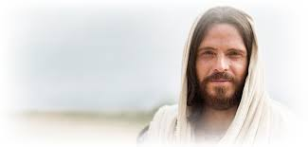
Why Study Statistics
Alma 32:27
But behold, if ye will awake and arouse your faculties, even to an experiment upon my words, and exercise a particle of faith, yea, even if ye can no more than desire to believe, let this desire work in you, even until ye believe in a manner that ye can give place for a portion of my words.
Doctrine and Covenants 93:24
“And truth is knowledge of things as they are, and as they were, and as they are to come“
Develop as a disciple of Jesus Christ
Notes:
If they have trouble thinking of a “why”, here are some ideas. Develop Christlike attributes: patience, humility, long suffering, charity, knowledge, etc..

Slide 9
Grit and Growth Mindset Lead to Success
The grit Angela Duckworth talks about, is a behavior that those who have a growth mindset will demonstrate.
What this video, then answer the following questions:
https://www.youtube.com/watch?v=ELpfYCZa87g
What is neuroplasticity?
How does neuroplasticity work?
How can you “rewire” your brain?
What is growth mindset?
Notes:
Activities for learning/teaching about growth mindset: https://docs.google.com/viewerng/viewer?url=https://www.mindsetkit.org/static/files/YCLA_LessonPlan_v10.pdf
Another great resource for how to explain growth mindset in 2-3 minutes is here: https://www.youtube.com/watch?v=Fj5k6KAvt18

Slide 10
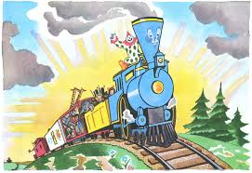
You Can Do This
God did not allow you into this university and spend tithing dollars on you, so that you could fail. He has given many resources to help you succeed:
Classmates
Teacher
TA
Mathlab/Tutoring Center
Holy Ghost
“…Our Heavenly Father did not put us on earth to fail but to succeed…”
Richard G. Scott, Oct. 1989 Gen. Conf.
Notes:
One thing to walk away from today it is this:
This class and University experience is designed to aid in your discipleship of Jesus Christ
You can succeed in this class because you have the loving support of God, angels, classmates, faculty and staff

Slide 11
Overview
Introductions: who am I, who are you?
How to succeed in the course?
Tour of the syllabus / I-learn

